Slide 1
Faith – believe, trust, lean – (opposite is unbelief)
Senses connect us to this physical world
Faith connects us to the things we cannot see (unseen)
Many kinds of faith, but Biblical Faith connects us to the invisible / eternal reality of God Himself and His word
In the world – seeing is believing, in scripture believing is seeing
Faith is more about how you live than what you know. We need both understanding and action.

Slide 2
Luke 17:3-6 Faith and the Mulberry Tree
Be on your guard! If your brother sins, rebuke him; and if he repents, forgive him. ⁴ And if he sins against you seven times a day, and returns to you seven times, saying, ‘I repent,’ you shall forgive him.”
⁵ The apostles said to the Lord, “Increase our faith!” ⁶ But the Lord said, “If you had faith the size of a mustard seed, you could say to this mulberry tree, ‘Be uprooted and be planted in the sea’; and it would obey you.

Slide 3
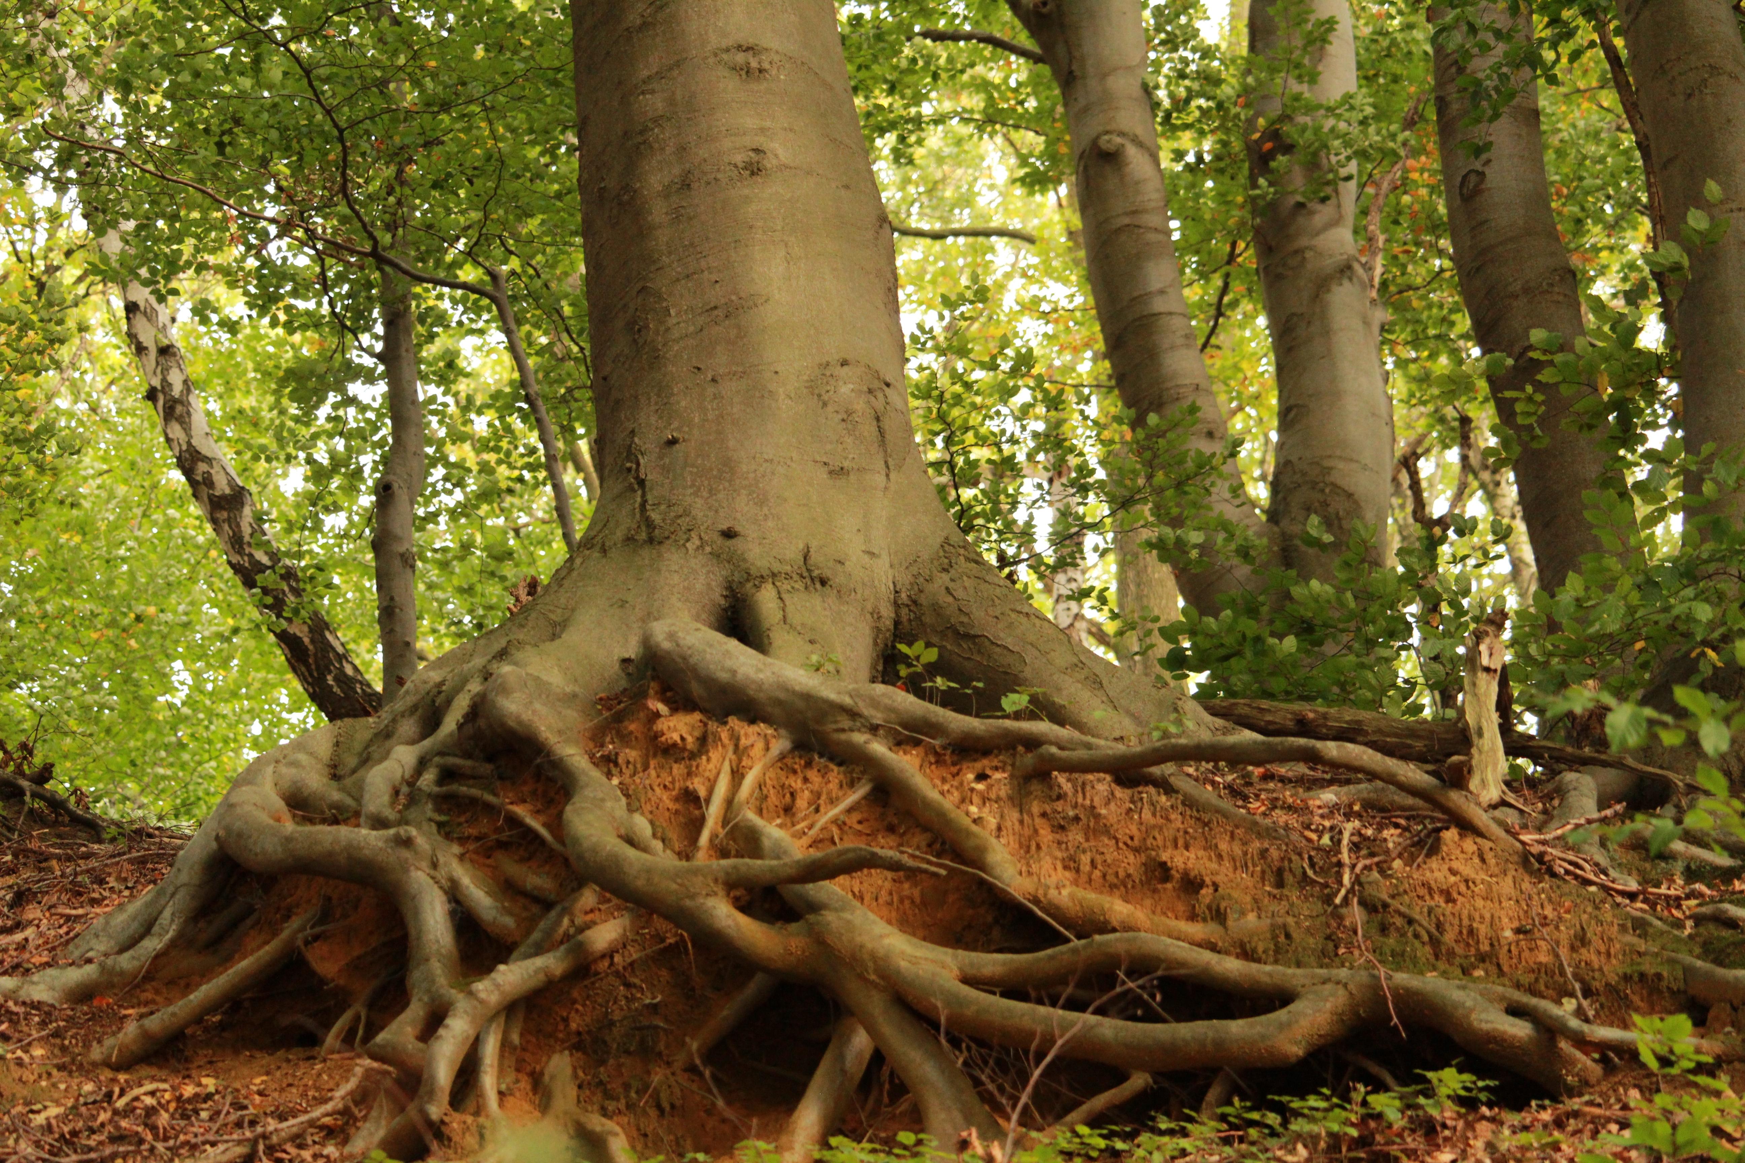

Slide 4
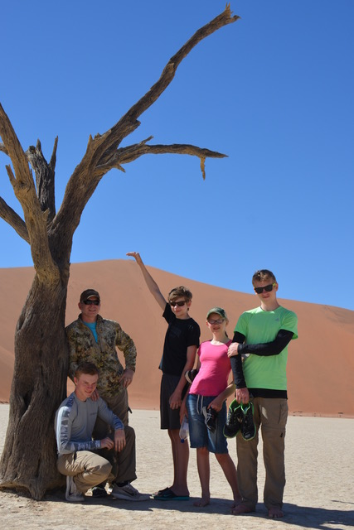

Slide 5
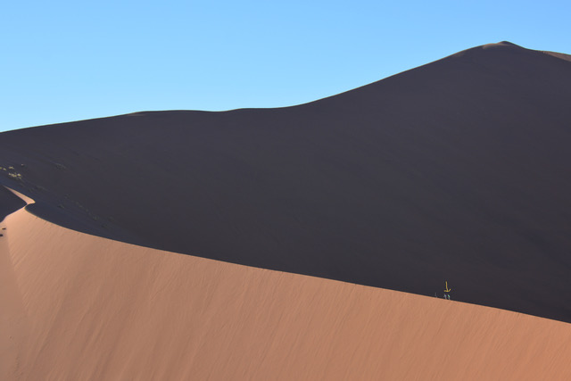

Slide 6
The Power of Jesus Over a Demon – Matthew 17:14-20
¹⁴ And when they came to the crowd, a man came up to him and, kneeling before him, ¹⁵ said, “Lord, have mercy on my son, for he has seizures, and he suffers terribly. For often he falls into the fire, and often into the water. ¹⁶ And I brought him to your disciples, and they could not heal him.” ¹⁷ And Jesus answered, “O faithless and twisted generation, how long am I to be with you? How long am I to bear with you?
Bring him here to me.” ¹⁸ And Jesus rebuked the demon, and it came out of him, and the boy was healed instantly. ¹⁹ Then the disciples came to Jesus privately and said, “Why could we not cast it out?” ²⁰ He said to them, “Because of your little faith. For truly, I say to you, if you have faith like a grain of mustard seed, you will say to this mountain, ‘Move from here to there,’ and it will move, and nothing will be impossible for you.”

Slide 7
How to strengthen my faith:
1) Abide in Jesus / pray – John 15:1-5, Philippians 4:4-7, James 1:5
2) Meditate on God’s word and grow in obedience to it – James 2:22-26, Rom. 10:17, Psalm 1, John 14:23
3) Walk in community and fellowship with other believers – Hebrews 10:24-25, Romans 12
> What is one way I need to respond?
Share with someone what you decide…

