Slide 1
Faith is for today!

Slide 2
Faith central and vital to life in God
Hebrews 11:6 - “Without faith it is impossible to please God.”
2 Corinthians 5:7 - “We live by faith, not by sight.”
Ephesians 2:8 – By grace you have been saved, through faith
James 2:29 – So faith without deeds is dead

Slide 3
Faith
Senses connect us to this physical world
Faith connects us to the things we cannot see (unseen)
Biblical Faith – connects us to the invisible \ eternal reality of God Himself and His word

Slide 4
World vs Scripture
World – seeing is believing
Scripture – believing is seeing
- 2 Corinthians 4:16-18
- John 11:39-40
- Hebrews 11:3

Slide 5
Believing is SEEing
When we:
> fix the eyes of our heart on the nature / character of God
> we meditate on His words and promises
> step out in obedience in response
The truth of who He is and the power of His promises become reality in our life and experience here…

Slide 6
What Faith Means
Believe - Hebrew > root “aman” – stand firm, steady, faithful
      Greek > pisteuo - to trust in, rely on, and cling to
Trust – Hebrew > batakh, feel secure, rely on, lean on Greek > pistis (noun) pisteuō (verb) - faithful, belief, reliable, entrust oneself to

Slide 7
What Faith Means
Lean – Hebrew > sha’an – lean on, rely on, receive support from the one your leaning on
Faith – Hebrew > emunah – steadfastness, faithfulness, action showing reliance on and loyalty to God
      Greek > pistis – convinced, confident, trustworthy

Slide 8
Faith is for today!

Slide 9
Faith When Life Gets Difficult
The real test of faith comes under pressure.
When trials come:
Don't back up — lean in.
Don't give up — keep moving forward.
Don't rely only on what you see — trust God.

Slide 10
Faith Is for Today!
Don't let the enemy tell you: “Not today… tomorrow.”
- God meets us in the present
- He meets us as “I am”

Slide 11
What should I Do?
Surrender yourself / your situation to Him (I trust you)
As He speaks, stand on His word, with thanksgiving
Walk your faith out in steps of obedience

Slide 12
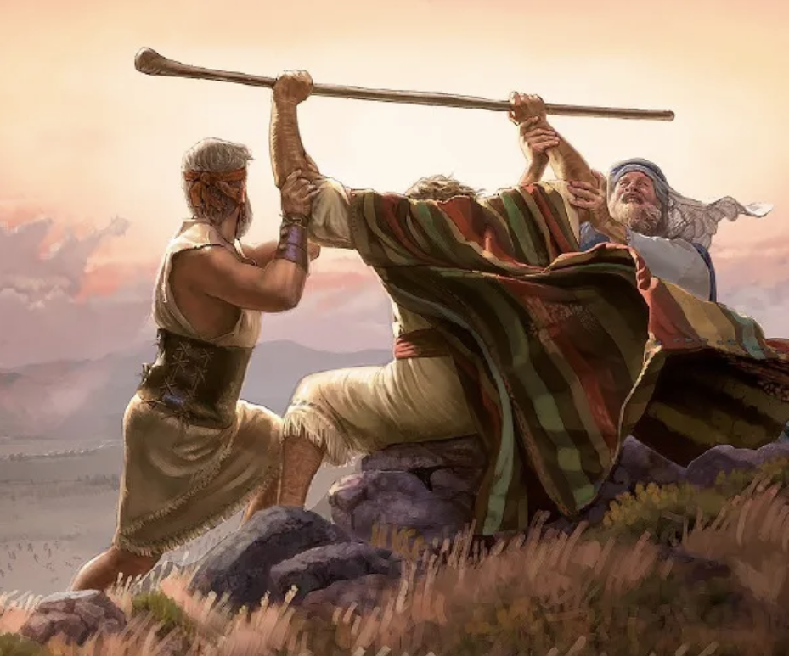
Exodus 17: 8 – 16
…so that his hands remained steadfast till sunset.
Emunah!

